Slide 1
phases of the cardiac cycle are
1-Atrial systole :
30% of blood pass from atria to ventricles by atrial systole
2-Isovolumetric contraction phase :
Increase ventricle pressure with no change in length of ventricle muscle (NO ventricle contraction in this phase )
3-Maximal ejection phase
Great amount of blood pass from ventricles to pulmonary artery and aorta
4-Reduced ejection phase
Less amount of blood pass from ventricles to aorta and pulmonary artery

Slide 2
5-Isovolumetric relaxation phase
Decrease ventricle pressure with no change in length of ventricle muscle (ventricle muscle shows no change in length ONLY pressure decreases )
6-Maximal filling phase
70% of blood pass from atrium to ventricle by gravity
7-Reduced filling phase
Blood pass from atrium to ventricle by gravity
(2,3,4 ) ----ventricle systole phases
(5,6,7) ----ventricle diastole phases

Slide 3
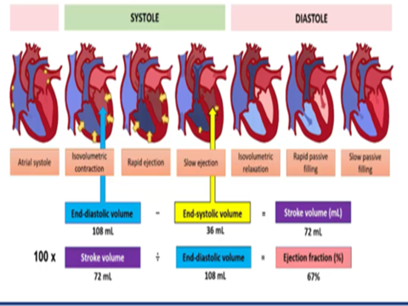

Slide 4
I-Atrial pressure changes during cardiac cycle
during atrial systole :
Increase atrial pressure (+ve a) due to systole of atria
Then decrease atrial pressure (-ve a) due to leave of blood from atria to ventricle by systole (30%)
During isovolumetric contraction phase:
Increase atrial pressure (+ve c) due to elevation of the A-V ring up by the increased ventricle pressure –this leads to decrease atrial volume and increase atrial pressure
During maximal and reduced ejection phases:
Decrease (-ve c) the blood leaves ventricles so the A-V ring falls down leading to increase atrial volume

Slide 5
During isometric relaxation phase :
Increase (+ve v) venous return fills the atria leading to increase atrial pressure
During maximal filling and reduced filling phases Decrease(-ve v) Decrease venous return to atria and blood leaves the atria to ventricles by gravity (70%) leading to decrease atrial pressure

Slide 6
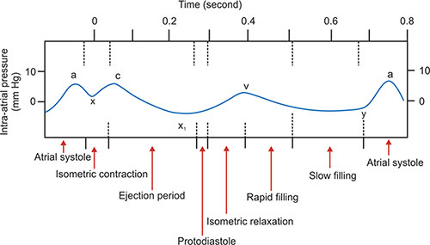

Slide 7
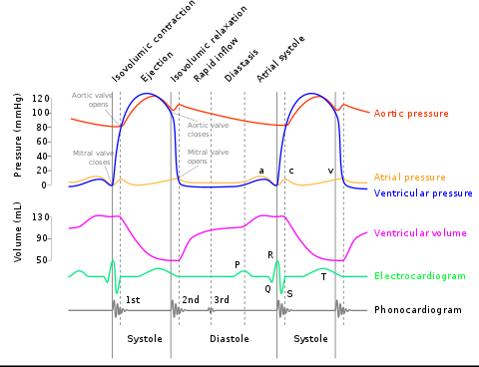

Slide 8
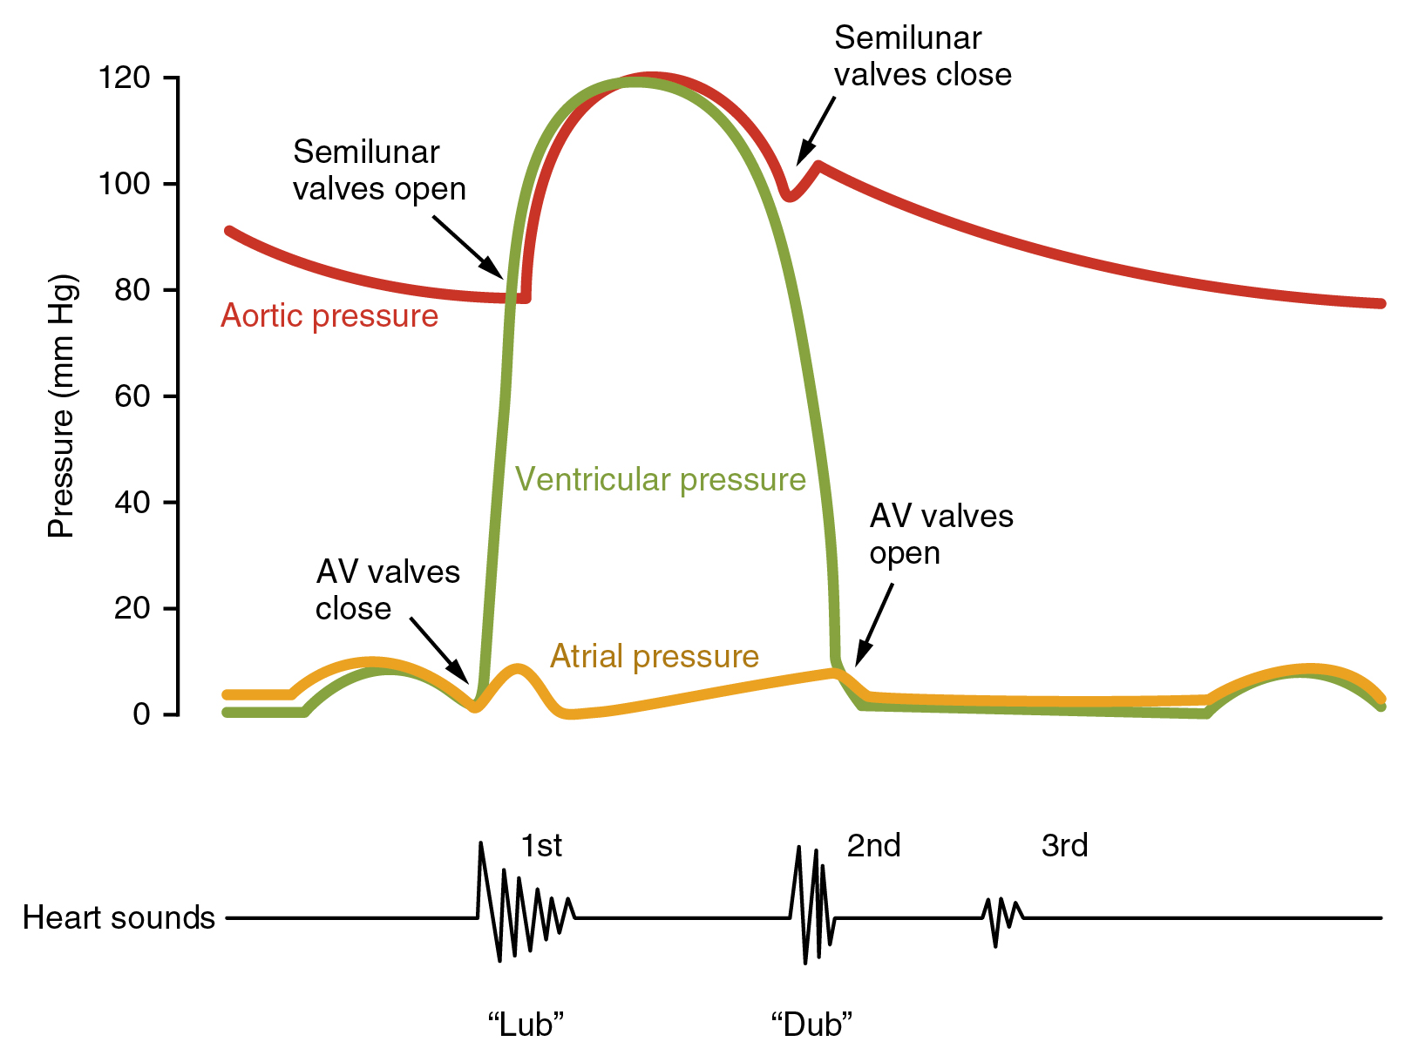

Slide 9
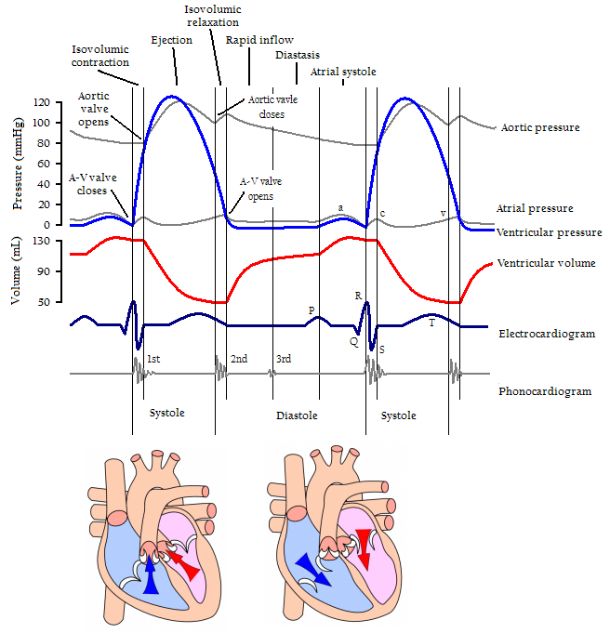

Slide 10
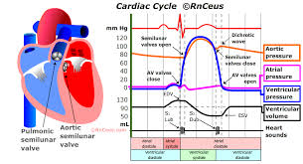

Slide 11
Ventricle pressure changes during cardiac cycle
During atrial systole phase:
Increase then decrease due to:
blood flows from atria to ventricle increase ventricle pressure then ventricle relax to accommodate the blood leading to decrease ventricle pressure
During isometric contraction phase :
Increase Pressure in ventricles with no change in volume of the ventricles to reach (80 mmHg)
During maximal ejection phase :
Increase Ventricle pressure due to contraction of ventricle --contract increase pressure in ventricles to reach 120 mmHg in left ventricle 25 mmHg in right ventricle

Slide 12
During reduced ejection phase :
Pressure begins to decrease due to Decrease flow of blood from ventricle to aorta ---decrease pressure in ventricles
During isometric relaxation phase
Decrease Ventricle pressure decreases without change in volume
During maximal and reduced filling phases
Increase Blood flows from atria to ventricles by gravity –increases ventricle pressure

Slide 13
State of the A-V valves :
atrial systole phase open
Isometric contraction phase closed
Maximal ejection phase closed
Reduced ejection phase closed
Isometric relaxation phase closed
Maximal filling and reduced filling phases Open

Slide 14
State of semilunar valves
Close in all phases of cardiac cycle except the two phases
-maximal and reduced ejection phases

Slide 16
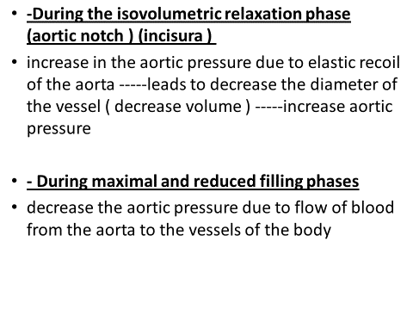

Slide 17
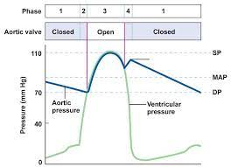

Slide 20
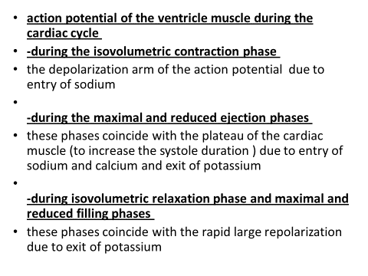

Slide 21
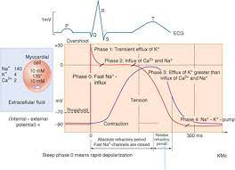

Slide 22
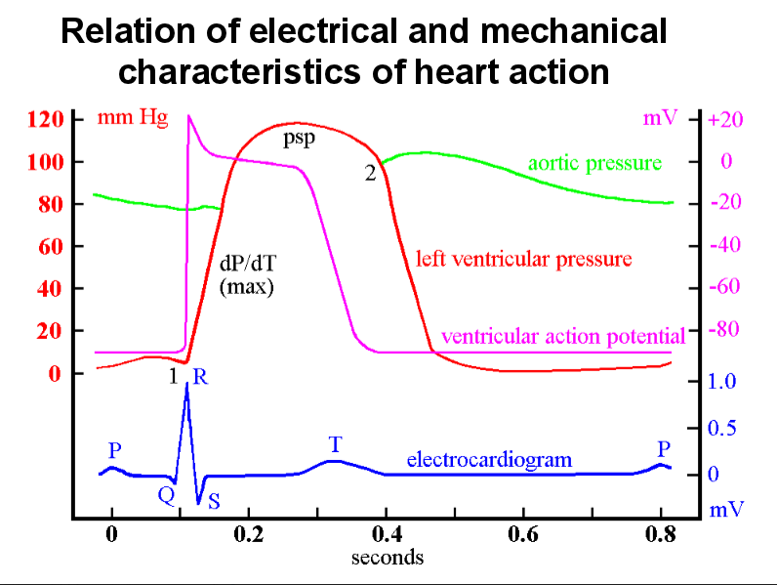

Slide 23
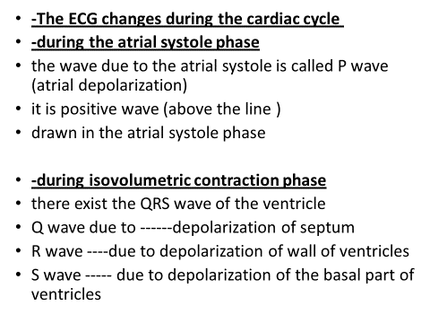

Slide 24
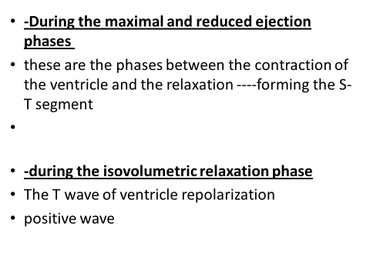

Slide 25
