Slide 1
CVS Cardiac Muscle
Practical

Slide 2
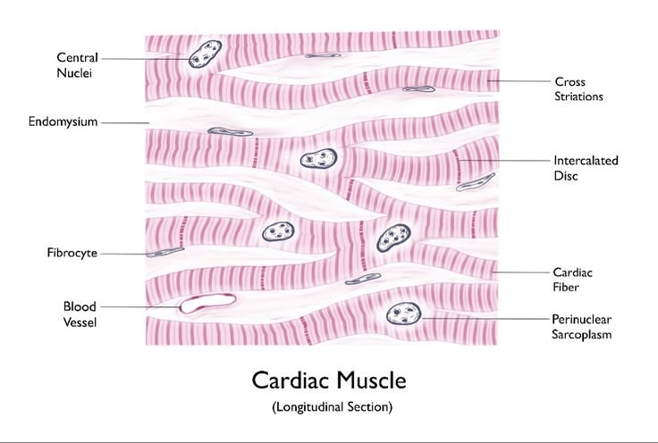
Cardiac Muscle

Slide 4
Intercalated discs

Slide 5
Intercalated discs

Slide 6
Wall of the heart + Valve

Slide 7
Cardiac Muscle T.S. with central nuclei

Slide 8
Purkinje muscle fibers

Slide 9
Purkinje muscle fibers

Slide 10
Purkinje muscle fibers

