Slide 1
Cardiac muscle
1-Site:-
Cardiac muscle is limited to the heart.

Slide 2
Cardiac muscle
2-Size of fiber:_
2- Diameter 15 um
Length 85-100 um
3-Shape of cardiac muscles: cylindrical, branched and having intercalated discs

Slide 3
4-SAROLEMMA:
It is very thin (not clear)
5-Nuclei: Single, Oval and Central
6-Sarcoplasm: Acidophilic, Granular, Less clear striations
Mitochondria,glycogen &lipofuscin granules.

Slide 4
7- Organization:_
Muscle fibers of the heart are arranged in different directions. Muscle fibers are surrounded by thin endomysium rich in capillaries.

Slide 5
8-Origin of cardiac muscle
The mesoderm cells of the heart tube are arranged like a chain . The cells may branch & bind to the cells in adjacent chain.

Slide 6
9-REGENERATION OF THE CARDIAC MUSCLE
No regeneration, healing occurs by fibrous tissue as a result of invasion by fibroblasts.

Slide 7
10-Type : Red muscle fiber
E.M of myofibrils:-
1- Non regular transverse striations.
2-Presence of intercalated disc.

Slide 8
INTERCALATED DISC
A junction complex between 2 cell membranes of 2 adjacent cardiac cells (at level of Z line)
It is step like [transverse &lateral]
The membranes are joined by:
1- Desmosome
2-adherent junction &
3-gap junction

Slide 9
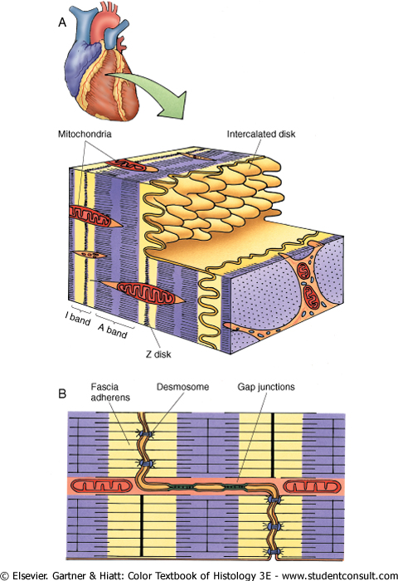
It is formed of transverse part &lateral part. 1-Transvers part across the fibers (vertical) [ facia adherens & desmoomes] preventing them from separation during contraction. 2- Lateral part:- -Run parallel to the myofilaments - Formed of gap junction allow ionic continuity so signal pass in waves from cell to cell..

Slide 10
E.M. OF sarcolemma & sarcoplasmic reticulum
1- Wide T tubule –sarcolemma- (wider than in skeletal )
2-T- tubule are present at the level of Z line
3-Poor sarcoplasmic reticulum.
4-T-tubule + one poorly dilated cisternae form → diad

Slide 11
Conducting system of the heart
It consists of S-A node, A-V node and bundle of Hiss. This system has modified muscle fibers called Purkinje fibers which conduct the impulses 5 times faster than cardiac muscles.
1-larger in diameter,
2-paler, vacuolated, non striated.
3-few peripheral myofibrils,
4-no itercalated discs
5-One or two nuclei.

