Slide 1
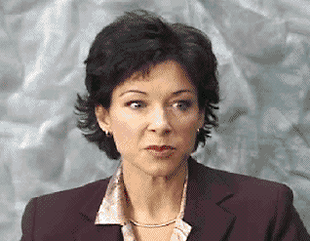
Case 1
In an outpatient clinic, a 31-year-old woman who is suffering from migraine headache of moderate severity; was prescribed a nasal spray that causes a selective vasoconstriction of the carotid vascular bed by stimulating 5-HT_{1D} receptors.
This drug is:
Almotriptan
Rizatriptan
Sumatriptan
Ergotamine
Ketoprofen

Slide 2
The correct answer is sumatriptan
The triptans and ergots
are agonists at 5-HT_{1B/1D} receptors
→ selective vasoconstriction of carotid vascular bed
However, only sumatriptan is available as nasal spray.
Ketoprofen is a NSAID (no action on 5-HT receptors)
For outpatients with moderate to severe migraine, we typically begin migraine therapy with a triptan

Slide 3
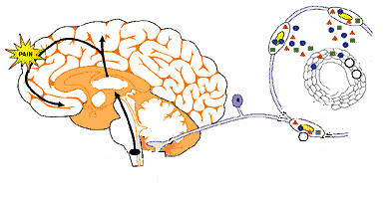
What is the mechanism of action of sumatriptan?
& Decreases Cortical sensitization
2. Inhibits Neuropeptide release
Vascular 5HT_{1b/d}
3. Vasoconstriction
1. Inhibits Pain signal transmission
Peripheral 5HT_{1b/d}
Central 5HT_{1b/d}
Notes:
Although many drugs are introduced for treatment of migraine, triptans are the best drugs for control of the acute attack.
They activate central 5HT1D receptors with subsequent decrease in Pain signal transmission & Cortical sensitization.
As well as trigeminal nerve terminal receptors with subsequent decrease in neuropeptide release.
They also activate 5HT1B which mediate cerebral VD

Slide 4
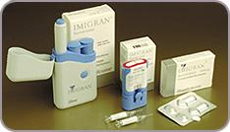
How triptans are given in acute migraine?
Sumatriptan can be given as a SC
(usually administered by autoinjector in the thigh),
Or as a nasal spray, or orally.
Zolmitriptan is also available for both nasal and oral use.
The other triptans are available for oral use only.

Slide 5
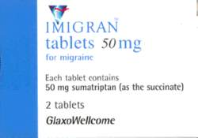
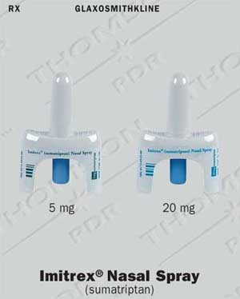
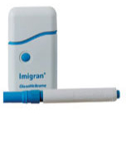
What is the dose of sumatriptan in acute migraine?
Oral: A single dose of 50 mg to be repeated if a satisfactory response has not been obtained at 2 hours (Max dose 200 mg).
Intranasal: single dose of 5-10 mg administered in one nostril. If higher doses are needed, apply it in the two nostrils. If headache returns, repeat it once after 2 hours.
SC: 6 mg; a second injection may be repeated at least 1 hour after the initial dose.
The safety of treating an average of >4 headaches in a 30-day period has not been established.
Imigran®-Inject (mit Glaxo Pen)

Slide 6
What are the expected adverse effects of sumatriptan?
Related to method of administration:
Injection site reaction (with SC)
Unpleasant taste (with intranasal)
Related to its effect on sensory transmission:
Paresthesias
Feeling of warmth
Related to its vasoconstrictor action
Chest pressure (resolves spontaneously)
Flushing (autoregulation)
General reaction:
Weakness, malaise
Dizziness, drowsiness

Slide 7
If sumatriptan fails, can you give ergots after it?
No
Avoid ergotamine use within 24 hours of triptans or other serotonin agonists
Triptans
Ergots
5-HT_{1A}
Serotonin Syndrome

Slide 8
What are the other serious drug interactions with triptans?
Serotonin Syndrome
Sibutramine
MAOIs
Monamine pump
MAO
5-HIAA
5-HT
Triptans
5-HT_{1A}

Slide 9
Are simple analgesics a good choice in acute migraine?
Some patients with migraine have an optimal response with mild analgesics.
Acetaminophen +NSAID + caffeine as abortive agent.
NSAIDS in suppository forms may be helpful for nauseated patients.
However, frequent use → rebound headaches.

Slide 10
What are the other drugs used for the acute attack?
Ergots: 5HT 1_{b}/1_{d} agonists
Anti-emetics: dopamine receptor antagonists
-ditans (e.g. Lasmiditan): 5HT-1_{f} receptor agonist
-gepants: Calcitonin-Gene Related Peptide antagonists

