Slide 1
CVS Vascular system
Practical

Slide 2
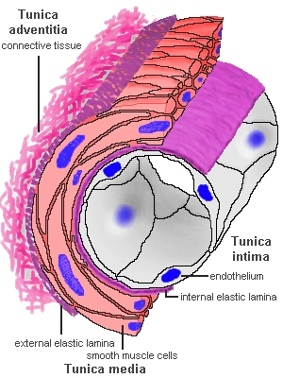
WALL OF A BLOOD VESSEL

Slide 3
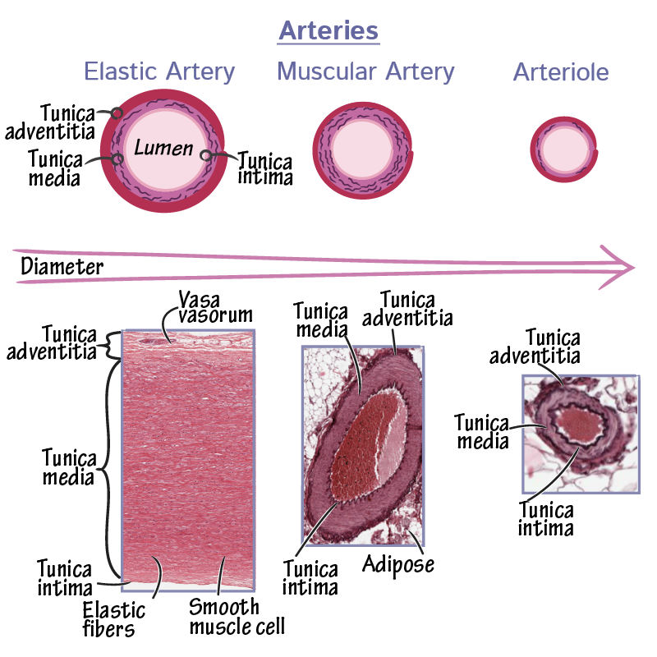
Arteries

Slide 4
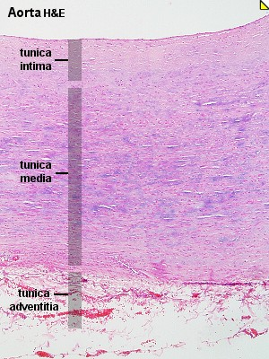
Aorta

Slide 5
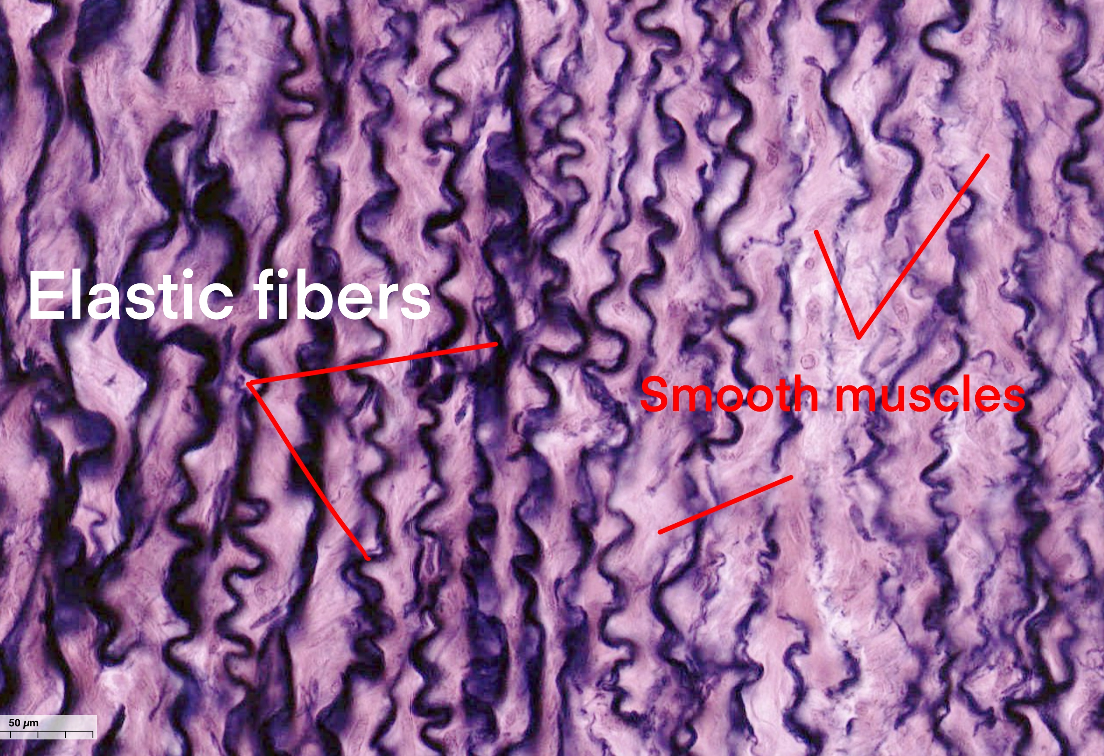
Aorta

Slide 6
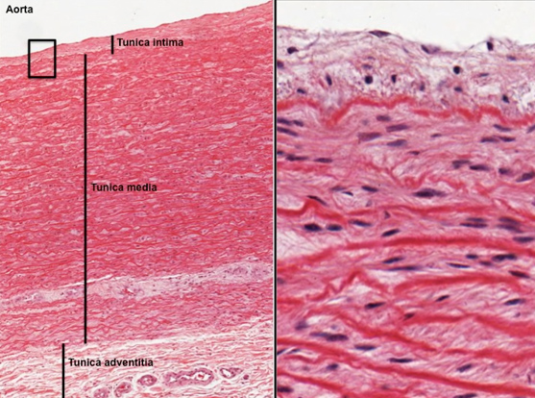
Aorta
Vasa vasorum

Slide 7
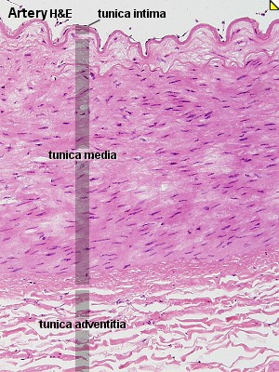
Medium sized artery

Slide 8
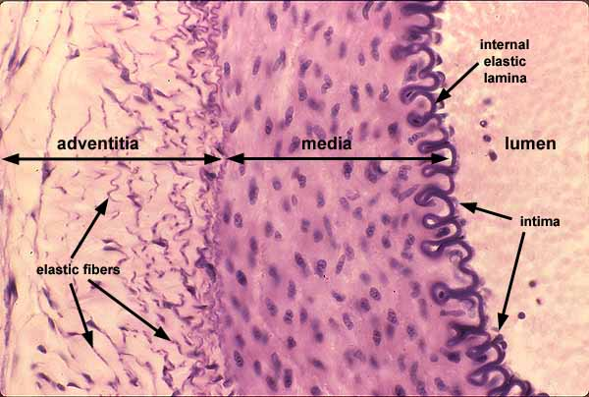
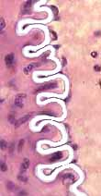
Internal elastic lamina

Slide 9
Medium sized vein

Slide 10
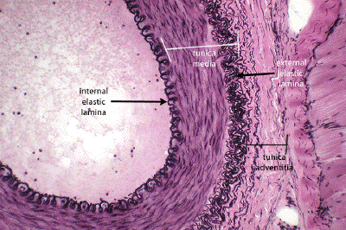
Medium sized artery & vein

Slide 11
Medium sized artery & vein

