Slide 1
Curves-Adrenergic System

Slide 2
Which of the following is true about epinephrine?
  It stimulates α-1 receptors.
  It stimulates β-1 receptors.
  It stimulates α-2 receptors.
  It stimulates β-2 receptors.
  All of the above
Foil “e” is correct: epinephrine –unlike noreinehrine- stimulates all adrenoceptors.

Slide 3
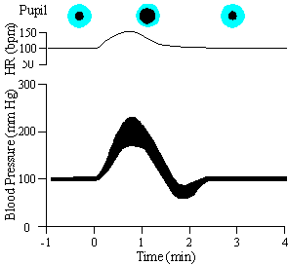
The first drug we will administer is
Epinephrine 2 μg /kg IV

Slide 4
Factors responsible for the rise in blood pressure include:
  Increased myocardial contraction.
  Increased heart rate.
  Vasoconstriction of the vascular beds.
  Vagal reflexes.
Foils “a, b, c” are correct: Vagal reflexes are triggered by the effect of increased BP on baroreceptors and tend to return it back to normal.

Slide 5
In this blood pressure tracing, you may have noticed that the effect of epinephrine on blood pressure was quickly terminated. Which factors may contribute to the rapid termination of the actions of epinephrine?
Metabolism by COMT.
Metabolism by MAO.
Reuptake mechanisms.
Metabolism by esterases.
Foils “a”, “b” and “c” are correct: Although the action of neuronally-released norepinephrine is terminated primarily by reuptake, COMT and MAO metabolism plays an important role in terminating the action of exogenously administered epinephrine and norepinephrine. Esterases play a role in termination of action of acetylcholine

Slide 6
Recall in the graph of epinephrine administration, after the increase in blood pressure, the pressure made a slight dip below the base line before returning to normal. What is (are) the most likely explanation(s) for this?
The BP falls so fast that this is a normal rebound phenomenon.
This is a result of β-2 receptor stimulation.
The α receptors become tolerant to continued stimulation.
This results from the “low dose” effect of epinephrine.
Foils “b, d” are correct: Epinephrine -at low dose- stimulates the β-2 receptor resulting in vasodilation and decrease of the arterial blood pressure. This may appear at the end of the pressure tracing when the effect of α receptors disappears.

Slide 7
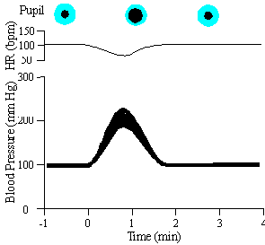
This is the effect of
Norepinephrine 1μg /kg

Slide 8
The rise in blood pressure produced by norepinephrine results from:
Increased cardiac output
Increased total peripheral resistance.
β receptors stimulation.
α receptors stimulation..
The second and fourth foils are correct: The rise in blood pressure is primarily due α-1 receptor stimulation resulting in vasoconstriction and increased total peripheral resistance. Think of how the responses would be modulated by reflex activity. The cardiac output decreased due to reflex bradycardia as well as vasoconstriction.

Slide 9
Hopefully, you noticed that norepinephrine produced a decrease in heart rate. The decrease in heart rate resulted from:
A direct β-stimulant effect on the heart.
Increased baroreceptors activity.
A direct α-stimulant effect on the heart.
Reflex activation of the parasympathetic system secondary to the rise of blood pressure induced by norepinephrine.
The second and fourth foils are correct: Norepinephrine –unlike epinephrine- leads to marked rise in BP due to unopposed α-action. This triggers the parasympathetic (vagal) reflexes.

Slide 10
If the animal had been previously vagotomized, norepinephrine would have produced an increase in heart rate instead of a decrease. Such an effect would be a manifestation of:
α receptors stimulation induced by norepinephrine.
A reflex increase in sympathetic activity.
β-2 receptors stimulation induced by norepinephrine.
β-1 receptors stimulation induced by norepinephrine.
Only foil “d” is correct: The heart contains both β-1 (80%) and β-2 (20%); however, norepinephrine stimulates only β-1 adrenoceptors.

Slide 11
A sufficiently small dose of epinephrine will produce a decrease in mean BP. What will happen with administration of a comparably small dose of norepinephrine?
There will be a decrease in mean BP similar to epinephrine.
The mean BP would probably increase.
There will be a greater decrease in mean BP than with epinephrine.
The dose will primarily stimulate β-2 receptors.
The correct answer is b.
There is no “low dose” effect with norepinephrine. That dip which you saw in the graph of epinephrine is a result of the “low dose” effect of epinephrine. That is, because the blood concentration of epinephrine is being reduced by reuptake and metabolism, the concentration the receptors are exposed to becomes so small that we see a predominant β-2 effect on the blood pressure. We do not see this with norepinephrine because the drug has little or no effect on β -2 receptors.

Slide 12
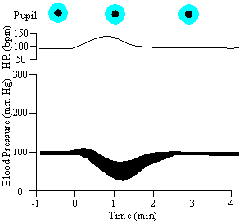
This is the effect of
Isoproterenol HCI 1 μg /kg

Slide 13
What would you expect the mean BP to be after administration of isoproterenol?
The same or slightly higher
lower
Unchanged
Much higher
None of the above
The answer is b. Cardiac output is increased due to the positive inotropic and chronotropic effects of the drug. An increased cardiac output is generally able to cause an increased systolic pressure. However, there is a very strong effect of β -2 receptor activation. The β -2 effect of the drug causes a marked decrease in the diastolic blood pressure blood pressure and the net effect is a fall in the mean blood pressure.

Slide 14
Other actions of isoproterenol include:
  Bronchodilation.
  Decreased uterine tone.
  Decreased GI motility.
  Increase in plasma free fatty acids.
All foils are correct.

Slide 15
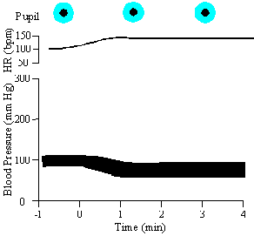
We now proceed to the administration of our next drug, Phentolamine HCI, 2 mg/kg

Slide 16
Which of the following is true about phentolamine?
  Phentolamine is a competitive α receptor blocker.
  Phentolamine exerts a ‘sympatholytic’ effect in the heart.
  The mean BP increased after phentolamine administration.
  The pupil diameter will increase with phentolamine.
  All of the above.

Slide 17
The widening pulse pressure accompanied by a decreased mean blood pressure can be attributed in part to:
  Vasodilation due to α-1 receptor blockade.
  Increased parasympathetic discharge.
  Decreased myocardial contractility.
  Decreased HR.
  All of the above.
Only foil “a” is correct. Phentolamine-induced hypotension leads to cardiac stimulation since it triggers reflex sympathetic activation.

Slide 18
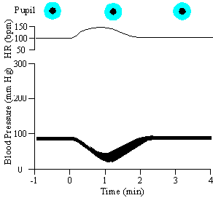
Epinephrine after administration the α-blocker phentolamine

Slide 19
After administration of an α blocker, what would you expect the mean blood pressure to be on subsequent administration of epinephrine?
  The BP would decrease due to stimulation of β-2 receptors in the blood vessels.
  The BP would stay the same due to α receptor blockade.
  The BP would increase due to β-2 receptor stimulation.
  The BP would increase due to α receptor blockade.
  The BP would decrease due to stimulation of β-1 receptors in the heart.
Only foil “a” is correct: after α receptors blockade, epinephrine acts the same as isoproterenol (isoprenaline). The phenomenon where the blood pressure decreases with a “high” dose of epinephrine, after administration of an α blocker, is known as “epinephrine reversal”.

Slide 20
There is no mydriasis in this case because:
  β receptors are stimulated.
  β receptors are blocked.
  β receptors are not stimulated.
  α receptors are stimulated.
  α receptors are blocked.
Only Foil “e” is correct: The dilator pupillae muscle contains α receptors only.

Slide 21
In the previous BP tracing, the HR increased when the blood pressure dropped. This resulted from:
  Reflex decrease in parasympathetic tone.
  Reflex increase in sympathetic tone.
  β receptor activation.
  A direct effect of epinephrine on the heart.
All foils are correct: In addition to the direct cardiac β-1 stimulatory effect of epinephrine, the hypotensive effect after phentolamine leads to activation of the sympathetic and inhibition of the parasympathetic reflexes on the heart.

Slide 22
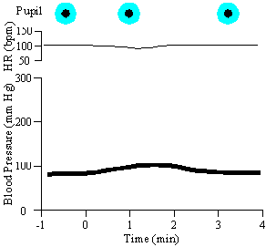
Norepinephrine after administration the α-blocker phentolamine

Slide 23
Notice that the administration of phentolamine has markedly reduced the rise in blood pressure produced by norepinephrine. This of course, is related to the fact that the vasoconstrictor action of norepinephrine is antagonized by phentolamine. However, phentolamine did not reverse the pressor response to norepinephrine, as was the case with epinephrine.

Slide 24
What is the best explanation for this different effect of norepinephrine when compared to epinephrine?
  Norepinephrine has a much greater stimulant action than epinephrine at α-1 receptors.
  Norepinephrine has little or no agonistic action at β-1 receptors.
  Norepinephrine is a potent β-2 receptor agonist
  Norepinephrine has little or no stimulant action at β-2 receptors.
  Norepinephrine is a potent β-1 stimulant
Only foil “d” is correct: After α receptors blockade, norepinephrine acts on cardiac β-1 receptors leading to slight increase in BP.

Slide 25
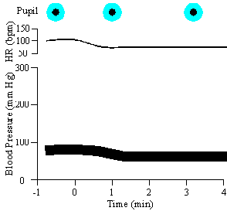
Isoproterenol HCI after administration the α-blocker phentolamine

Slide 26
What would you expect its effect on mean blood pressure to be now that phentolamine has been administered?
  BP will decrease the same as it did before phentolamine.
  BP will increase due to increased cardiac output
  BP will decrease more markedly than before phentolamine.
  BP will decrease due to decreased HR.
  All of the above are possible.
The answer is c. Think about what actions are blocked. The hypotensive effect of phentolamine is summated to that of isoprenaline. This is what happens when we give isoproterenol after phentolamine.

Slide 27
Why the action of isoproterenol is prolonged compared to its effects before phentolamine?
  The β-2 receptors are now more sensitive to the drug.
  The α receptors are no longer responsive to sympathetic reflexes.
  The β-1 receptor-mediated response is blocked.
  The β-2 receptors are blocked.
  None of the above.
The answer is b. The counter regulatory reflex sympathetic stimulation (which is triggered by the hypotensive effect of isoproterenol) does not work because the α receptors are already blocked.

Slide 28
The next drug will be
Propranolol HCI a dose of 0.5 mg/kq
It must be given very slowly; otherwise our cat might not survive.

Slide 29
After administration of phentolamine and propranolol to this cat, we have effectively blocked the:
  α-1 receptors.
  β-1 receptors.
  α-2 receptors.
  β-2 receptors.
All foils are correct.

Slide 30
If we re-administer isoproterenol HCI 1 μ/kg, what would you expect the response to be?
  No change in systolic BP.
  No change in HR.
  No change in diastolic BP.
  No change in mean BP.
All foils are correct.

Slide 31
The cat we have been working with has been treated with both phentolamine and propranolol. Although these are both competitive inhibitors, it would take at least several hours for their effects to wear off completely such that they would not interfere with the effects of a few additional adrenergic agents we need to look at.
Thus, we will start a new series of experiments using a fresh cat which has been prepared as described earlier and has not been treated with any adrenergic agonists or antagonists.

Slide 32
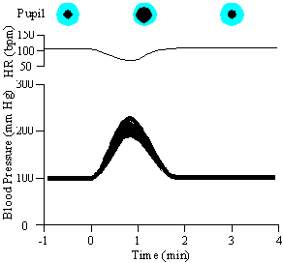
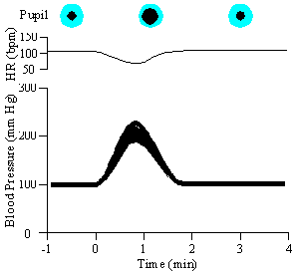
The first drug is
Norepinephrine 1 μg/kg
The next drug is Tyramine 10 μg/kq
(The response to tyramine looks pretty similar to those induced by norepinephrine.)

Slide 33
Tyramine acts by:
  Inhibiting α receptors.
  Directly stimulating β receptors.
  Directly stimulating α receptors.
  Stimulating release of norepinephrine.
  inhibiting release of norepinephrine
Only foil “d” is correct. Tyramine –like ephedrine and amphetamine- is an indirectly acting sympathomimetic agent.

Slide 34
Which of the following do you predict? Tyramine will:
  Not change in BP or HR.
  Decrease BP and HR.
  Increase BP and HR.
  Decrease BP and increase HR.
  Increase BP and decrease HR
The answer is e. Think of what norepinephrine does. The rise in blood pressure is primarily due to norepinephrine released from adrenergic neurons. Remember, HR decreases in response to norepinephrine as a result of the baroreceptors reflex.

Slide 35
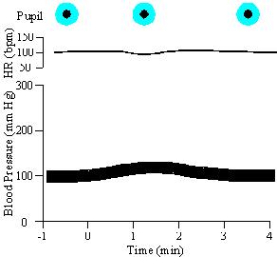
If we repeated the administration of the same dose of tyramine several times

Slide 36
Which of the following would you expect on repeated the administration of tyramine ?
  No change in the response.
  A markedly exaggerated response.
  A markedly depressed response.
  A reversed response.
The answer is c. A limited pool of norepinephrine is available for release by tyramine resulting in the rapid development of tolerance or tachyphylaxis. Let’s try tyramine again and see.

Slide 37
Notice that the rise in blood pressure and decrease in heart rate are markedly reduced when compared to what we saw before.
To rule out desensitization at, or subsequent to, the receptor level, let’s see if the response to norepinephrine has changed.

Slide 38
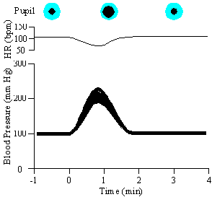
Norepinephrine 1 μg /kg after tyramine
The response looks pretty much the same as it did before

Slide 39
Which of the following would inhibit responses to tyramine, but tend to enhance responses to norepinephrine?
  Inhibition of α receptors.
  Inhibition of β receptors.
  Inhibition of both α and β receptors.
  Inhibition of neuronal reuptake.
Only foil “d” is correct: The effect of norepinephrine is enhanced since its termination of action by reuptake is inhibited.

Slide 40
Which of the following would be a good drug for us to use as a reuptake inhibitor in our experiments?
  Phenylephrine
  Imipramine
  Prazosin
  Amphetamine
  Pargyline
Only foil “b” is correct: Imipramine is a TCA that inhibits the reuptake pump of monoamines. Phenylephrine is a selective α-1 agonist while prazosin is a selective α-1 blocker. Amphetamine is an indirectly acting sympathomimetic that releases as well as inhibits the reuptake of norepinephrine. Pargyline is a MAOI.

Slide 41
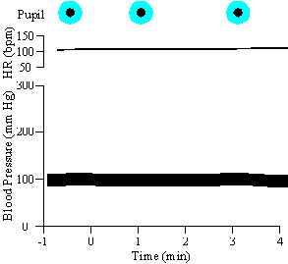
Tyramine 10 μg/kg after imipramine

Slide 42
This is the effect of tyramine 10 μg/kg after imipramine. Imipramine essentially abolished the response to tyramine.
By now, we have waited long enough for the response to tyramine to return to control levels (particularly since we have also administered norepinephrine which would also tend to reload depleted neuronal pools).
Let’s see what the administration of imipramine 2.5 mg/kg does to subsequent responses to tyramine and norepinephrine.

Slide 43
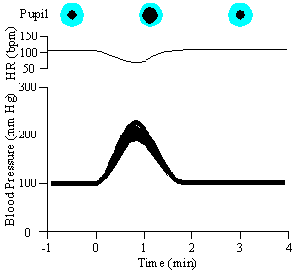
This is the effect of norepinephrine 1 μg /kg after imipramine

Slide 44
The response looks relatively unchanged. Although you might have expected more dramatic potentiation of norepinephrine in the presence of an uptake inhibitor, this is largely balanced by a simultaneous action of imipramine to inhibit alpha adrenergic receptors.

Slide 45
Pretreatment with which of the following would you expect to also inhibit responses to tyramine, but not responses to norepinephrine?
  Phenoxybenzamine
  Tranylcypromine
  Cocaine
  Iproniazid
  Yohimbine
Only foil “c” is correct: Cocaine inhibits the neuronal reuptake of norepinephrine as well as of tyramine. Phenoxybenzamine is a selective α-1 blocker while yohimbine is a selective α-2 blocker. Tranylcypromine & iproniazid are MAOIs.

Slide 46
Effects of reserpine include:
  Inhibition of dopamine uptake into vesicles within adrenergic nerve endings.
  Inhibition of norepinephrine synthesis.
  Depletion of norepinephrine from adrenergic nerve endings.
  Inhibition of norepinephrine reuptake at the neuronal membrane.
The first and third foils are correct.
Except at extremely high concentrations attainable in vitro, reserpine does not inhibit the amine pump which transports norepinephrine and other amines across the neuronal membrane.

