Slide 1
Curves-Cholinergic System

Slide 2
Acetylcholine
1. Actions
A) Nicotinic Receptors
Nm
  Skeletal muscles
  → Muscle contraction
Nn
Autonomic ganglion
→ Ganglion stimulation
Nn
Adrenal gland
→ Adrenaline secretion

Slide 3
B) Muscarinic Receptors
  CNS:
    → Excitatory M₁ & Inhibitory M₂
  Heart: :
    → Inhibitory M₂
  Exocrine glands & Smooth muscles M₃
    → secretory motor effect

Slide 4
Acetylcholine
2. Metabolism
Hydrolysis by ChE enzyme
 | True choline esterase | Pseudocholine esterase
Sites | Opposite cholinergic nerves | Plasma
Specific substrate | Ach | Succinylcholine
Essential for life | Yes | No
Regeneration | 120 days | 1 day

Slide 5
Which of the following is true about acetylcholine (Ach)?
  It stimulates the muscarinic receptors
  It stimulates the adrenal medulla
  It is released from parasympathetic pre- and postganglionic nerve endings
  It is a mediator at both sympathetic and parasympathetic ganglia
All foils are correct: Ach is released from all preganglionic nerves (sympathetic and parasympathetic), from all post ganglionic parasympathetic as well as from some post ganglionic sympathetic nerves (sympathetic cholinergic fibers). Ach is also released from the motor nerves to the skeletal muscles and from some nerve fibers in the CNS.

Slide 6
Ach would directly produce which of the following?
  Miosis
  Increased GI motility
  Bronchoconstriction
  Glycogenolysis
The first 3 foils are correct: Remember, Ach is secretory (to exocrine glands) motor (to smooth muscles). Glycogenolysis is mediated in human by β-2 adrenoceptors (85%) and α-1 adrenoceptors (15%).

Slide 7
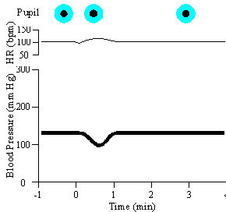
Finally, we are ready to see what happens with 0.1 μ/kg of Ach.
Why would there be minimal effects on the cardiovascular system with this dose of Ach?
Rapid destruction of the compound
Cardiovascular compensatory reflexes
The dose is small
Tolerance to Ach
Foils “a, b,c” are correct: The small dose of Ach stimulates endothelial M-3 receptors to release NO with subsequent vasodilatation and decrease of BP. The lack of effect on HR may be due to either rapid hydrolysis of the small dose of Ach before it reaches the heart or because Ach-induced bradycardia was counteracted by reflex sympathetic stimulation 2ry to decreased BP.

Slide 8
Which enzyme(s) is/are responsible for the rapid termination of the actions of Ach?
  Acetylcholine esterase
  MAO
  Anticholine esterase
  Pseudo-choline esterase
  Methyl choline esterase
Foils “a” and “d” are correct: Exogenous Ach is hydrolyzed both by plasma pseudo choline esterase as well as by nervous true Ach esterases.

Slide 9
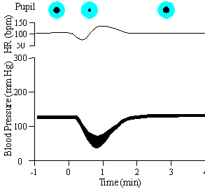
What happens when we increase the dose of Ach to 0.5 µg/kg?
The increase in the heart rate seen after the administration of the drug is due to
  Direct action of the drug on the heart
  Sympathetic reflex stimulation
  Complete metabolism of the drug by Ach esterase
  Vasoconstriction of the splanchnic vessels
  None of the above
Foils “b and c” are correct. Remember what happens to the blood pressure with Ach:
The HR and BP initially decrease due to a direct action of the drug on the muscarinic receptors of the heart and the endothelium lining the blood vessels. Because of reflex mechanisms, there is an increased sympathetic discharge producing an increase in the heart rate and returning the peripheral resistance toward normal. This, along with rapid destruction of Ach by cholinesterase restored the mean blood pressure. We must also remember that still larger doses of Ach also stimulate nicotinic receptors and cause the release of epinephrine and norepinephrine from both the adrenal medulla and the sympathetic postganglionic nerves.

Slide 10
The next drug will be neostigmine methyl sulfate
0.05 mg/kg
Neostigmine is a reversible anticholine esterase
In addition, it can directly stimulate the skeletal muscle nicotinic Nm receptors
Notes:
Neostigmine is a reversible anticholine esterase; leading to preservation of Ach (i.e. it prolongs the action of endogenous Ach on both muscarinic and nicotinic receptors). In addition, neostigmine can stimulate the skeletal muscle nicotinic receptors (Nm receptors) by itself
Neostigmine indirectly stimulates M-3 receptors through preservation of Ach. This results in contraction of the constrictor pupillae muscle (miosis) and ciliary muscle (accommodation) with subsequent opening of the canal of Schlem (decrease intraocular pressure). On the contrary, Ach dilates the intraocular blood vessels (leading to red eye).

Slide 11
The next drug will be neostigmine methyl sulfate (0.05 mg/kg):
Which of the following is a property of neostigmine?
  It is an anticholinesterase
  It blocks muscarinic receptors
  It acts on skeletal muscle
  It irreversibly binds to cholinesterase
Foils “a” and “c” are correct: neostigmine is a reversible anticholine esterase; leading to preservation of Ach with subsequent stimulation of both muscarinic and nicotinic receptors. In addition, neostigmine can stimulate the skeletal muscle nicotinic receptors (Nm receptors) by itself.

Slide 12
Now that we know that neostigmine is an anticholinesterase, let’s discuss what happens at some of the organs affected by this drug. When neostigmine is applied locally to the eye, which of the following changes can take place
  Miosis
  Decreased intraocular pressure
  Spasm of accommodation
  Constriction of the intraocular vessels
The first 3 foils are correct: Neostigmine indirectly stimulates M-3 receptors through preservation of Ach. This results in contraction of the constrictor pupillae muscle (miosis) and ciliary muscle (accommodation) with subsequent opening of the canal of Schlem (decrease intraocular pressure). On the contrary, Ach dilates the intraocular blood vessels (leading to red eye).

Slide 13
If neostigmine prolongs the action of endogenous Ach, what would we expect neostigmine’s effect on the BP to be?
  No change because there is little cholinergic innervation in the blood vessels
  The BP would markedly decrease due to enhanced effects of endogenous Ach
  The BP would markedly decrease because of the decreased HR
  The BP would increase because of sympathetic stimulation
  All of the above could occur
Foil “a” is correct.

Slide 14
Now if we give the same dose of Ach (0.1 μ/kg) after neostigmine
What will happen now if we give a small dose of Ach (0.1 μ/kg)?
  The BP will show the same effect as before the administration of neostigmine
  The response will be similar to a large dose of Ach
  The BP will remain the same
  There will be a prolonged increase in the BP
  There will be a decrease in the BP but less than before neostigmine
Only foil “b” is correct.

Slide 15
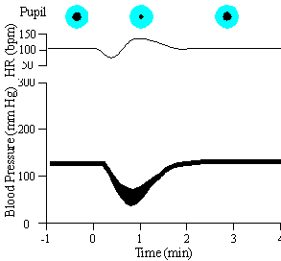
If we give 0.1 μ/kg of Ach after neostigmine, this is what happens: It produces the same action as a large dose.
What would happen if we administered Ach in a large dose (0.5 µg/kg) after neostigmine?
  There would be a parasympathomimetic effect
  There would be no change in the BP
  There would be a prolonged effect
  The BP would show a biphasic response characteristic of large doses of Ach
The correct answer is C: If a large dose of Ach is given after neostigmine you would still get the same response except that the magnitude and duration of the response would be greater since Ach is not metabolized.

Slide 16
The next drug to be administered will be atropine sulfate 1 µg/kg:
What would you expect the effects to be?
  Bronchoconstriction
  Increase in the heart rate
  Urinary incontinence
  Miosis
Only foil “b” is correct: Atropine is a competitive muscarinic blocker.

Slide 17
The following can be attributed to atropine administration:
  Constipation
  Mydriasis
  Dry mouth
  Increased urination
Foils “a”, “b” and “c” are correct: Atropine relaxes the smooth muscles and dries the exocrine secretions.
Nothing of any significance happens to the BP after the administration of atropine

Slide 18
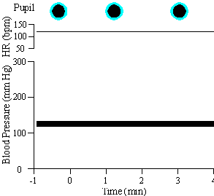
Ach will be given in a dose of 0.5 μ /kg:
After administration of this dose (0.5 µg/kg) of Ach, which of the following would be true?
  The muscarinic receptors are blocked so there will be an initial fall in the BP
  There will be a decrease in the mean BP
  There will be an increase in the mean BP
  There will be no change in the mean BP
Let’s refer to our pressure tracing to confirm what is happening
Foil “d” only is correct: Ach induces no change in BP since the muscarinic receptors were already blocked by atropine and the dose was too small to stimulate the nicotinic receptors.

Slide 19
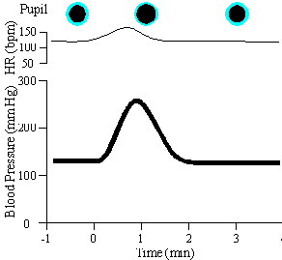
Now we gave Ach in a dose of 0.5 mg/kg:
What would you expect with this extremely large dose (Note that this dose is 1000 X larger than our previous dose of o.5 µg/kg):
  The BP would increase
  The BP would decrease then increase in a biphasic response
  The BP would decrease
  The BP would not significantly change
  None of the above
This is what happens with very large dose of Ach.
Only foil “a” is correct

Slide 20
Why, when we administered a dose of Ach which is extremely large, did we get an increase in BP?
  The vessels do not have any cholinergic receptors
  The muscarinic effect of Ach is effectively blocked by atropine so nicotinic effects become apparent
  This dose blocks the adrenergic receptors
  This dose stimulates the adrenergic receptors
  None of the above
Only foil “b” is correct: This is due to stimulation of the nicotinic receptors of the adrenal gland and sympathetic ganglia with subsequent release of epinephrine and norepinephrine.

Slide 21
Hexamethonium is the next drug which our animal will receive
Do you remember what the actions of hexamethonium are? Let’s see what you can recall. Hexamethonium has the following action(s)
It antagonizes the effects of nicotine
It antagonizes the effects of DMPP
It is a ganglionic blocker
It inhibits the muscarinic receptors
The first three foils are correct: Hexamethonium is a ganglion blocker; so it antagonizes the effects of ganglion stimulants as nicotine. You may not have heard of DMPP: it is short for dimethylphenylpiperazinium. (Now you know why most people called DMPP). Anyway, DMPP is a ganglionic stimulant which acts in a manner similar to nicotine.

Slide 22

Getting back to the ganglionic blocker, hexamethonium let’s see what happens when we administer a dose of 2 mg/Kg
Why did hexamethonium decrease the BP?
  Hexamethonium blocks beta receptors
  Hexamethonium stimulates muscarinic receptors
  Hexamethonium blocks sympathetic ganglia
  Vagal stimulation
  None of the above
Only foil “c” is correct: Although hexamethonium blocks both types of the autonomic ganglia; the effect of the sympathetic ganglia is dominant on BP.

Slide 23
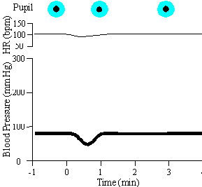
We are now ready to administer a super large dose of Ach (0.5 mg/kg) once again:
Let’s confirm our prediction, that a large dose of Ach in the presence of atropine and hexamethonium will cause a fall in blood pressure
Administration of Ach will now produce which of the following?
  No change in the mean BP
  No change in the systolic BP
  No change in the heart rate
  Decreased BP
Only the fourth foil is correct: Hexamethonium has blocked the nicotinic actions of the super large dose of Ach. The latter now produces a small fall in blood pressure as a manifestation of a residual effect on muscarinic receptors (which were incompletely blocked by the dose of atropine employed).

