Slide 1

إِنَّ الطَّبِيبِ بِطِّبِّهِ وَدَوَائِهِ لا يَسْتَطِيعُ دِفَاعَ مَقْدُورٍ أَتَى
مَا لِلطَّبِيبِ يَمُوتُ بِالدَّاءِ الَّذِي قَدْ كَانَ يُبْرِئُ مِثْلَهُ فِيمَا مَضَى
هَلَكَ الْمُدَاوَى وَالْمُدَاوِي وَالَّذِي جَلَبَ الدَّوَاءَ وَبَاعَهُ وَمَنِ اشْتَرَى
محمد بن إدريس الشافعي

Slide 2
Rectal - Parenteral
Routes of Administration & Dosage forms

Slide 3
ILOs for lecture 3
(Rectal - Parenteral
Routes of Administration & Dosage forms)
List indications, advantages, disadvantages, dosage forms & instructions given to the patient for rectal route
List dosage forms for parenteral administration
List precautions. advantages & disadvantages of IV/IM/SC administrations
Enumerate other types of parenteral administration with examples

Slide 4
ENTERAL route 3. Rectal
Indications:
To facilitate bowel emptying
  e.g. glycerin suppositories
To produce a local action e.g.
  anti-inflammatory drugs in ulcerative colitis
  anaesthetics in anal fissures
To produce a systemic effect e.g.
  antipyretics in fevers
  aminophylline in nocturnal asthma

Slide 5
Rectal route ………………… (cont.)
Advantages:
Suitable for
Children
In presence of vomiting or coma
Irritant drugs e.g. aminophylline
Action is
Prompt onset
Prolonged duration of action
Disadvantages:
Erratic absorption
Disagreeable
Proctatitis

Slide 6
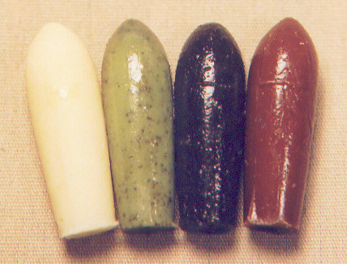
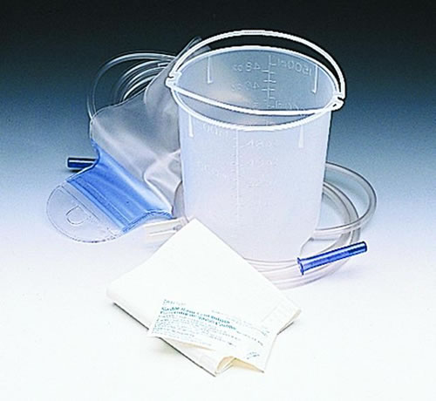
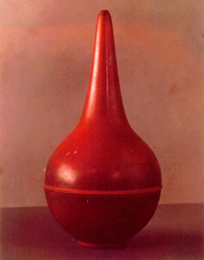
Rectal Dosage Forms
Suppositories Enemata

Slide 7
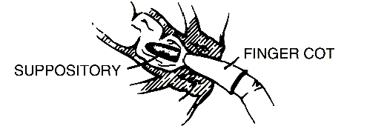
How to use rectal suppository
Empty the bowels (for retention type)
Position:
  squatting or
  lateral position
Proper insertion:
  Push far enough into the rectum
  The tapered end first so that it does not slip out
After insertion:
  Close your leg & sit still for a few minutes
  Avoid defecation for at least 1h

Slide 8
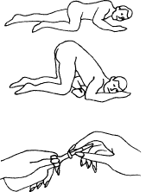
How to give the enema
Empty the bowels (for retention type)
Position:
  leaning forward
  left lateral position
Direction: enema tip is pointing toward the navel
Pressure:
  Evacuant enema: High pressure is applied
  Retention enema: Gentle pressure is applied & avoid defecation for at least 1h

Slide 9

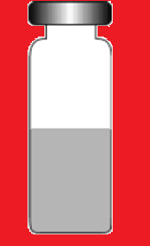

PARENTERAL route
LIQUID (INJECTIONS):
AMPOULES VIALS
SOLID (IMPLANTS):
e.g. contraceptive pellets

Slide 10
PARENTERAL: 1. Intravenous
Advantages:
Immediate onset (emergency)
100% bioavailability e.g. atracurium
Suitable for irritant drugs e.g. theophylline
Suitable for large volumes e.g. saline
Disadvantages:
Extravasations → local necrosis
Prolonged infusion → thrombosis
Cannula infection → bacteraemia & phlebitis
Wrong technique → air embolism

Slide 11
1. Intravenous (Precautions)
Be sure of dose
since the given drug cannot be recalled
Strict aseptic technique
to avoid introduction of infection
Well diluted + gradual administration
to avoid local phlebitis
Strictly intravenous
to avoid tissue necrosis
The vein is below the level of the heart
to avoid air embolism

Slide 12
PARENTERAL: 2. Intramuscular
Advantages:
Rapid absorption
100% bioavailability
Suitable for depot preparation
e.g. benzathine penicillin, monthly contraception
Disadvantages:
Unsuitable for large volumes (>5 ml)
Unsuitable for irritant drugs
Inadvertent IVI may occur
May be painful
May produce infected abscesses

Slide 13
PARENTERAL: 3. Subcutaneous
Advantages:
Slow: Prolonged duration of action
Steady: Uniform absorption
e.g. heparin & insulin
Suitable for drug too toxic by IV/IM e.g. adrenaline
May allows somewhat large volumes
If hyaluronidase is added
Disadvantages:
Very painful

Slide 14
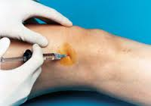
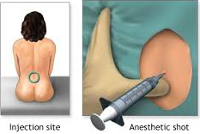
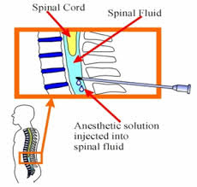
Other methods of injection
Intrarticular injection e.g. corticosteroid
Epidural injection e.g. opioid
Subarachinoid e.g. local anaesthesia
Intrathecal e.g. local anaesthesia

Slide 15
Summary
The rectal route is used to evacuate the rectum or to induce a local or systemic effect. There are 2 rectal dosage forms: suppositories & enemata
The parenteral route is used to introduce the drug by injection. There are 3 dosage forms: vial, ampoule, implant
The most commonly used parenteral route is the IV, less commonly the IM & SC. Rare parenteral routes include the epidural, spinal, intra-thecal & inra-articular.
The IV route is preferred in emergency, injection of large volumes, irritant drugs or drugs that can not be given orally
The IM route is preferred for depot preparations
The SC route is preferred if slow steady drug absorption is needed

